Slide 1
FORMATION, OWNERSHIP, AND OPERATION
OF BUSINESS

Slide 2
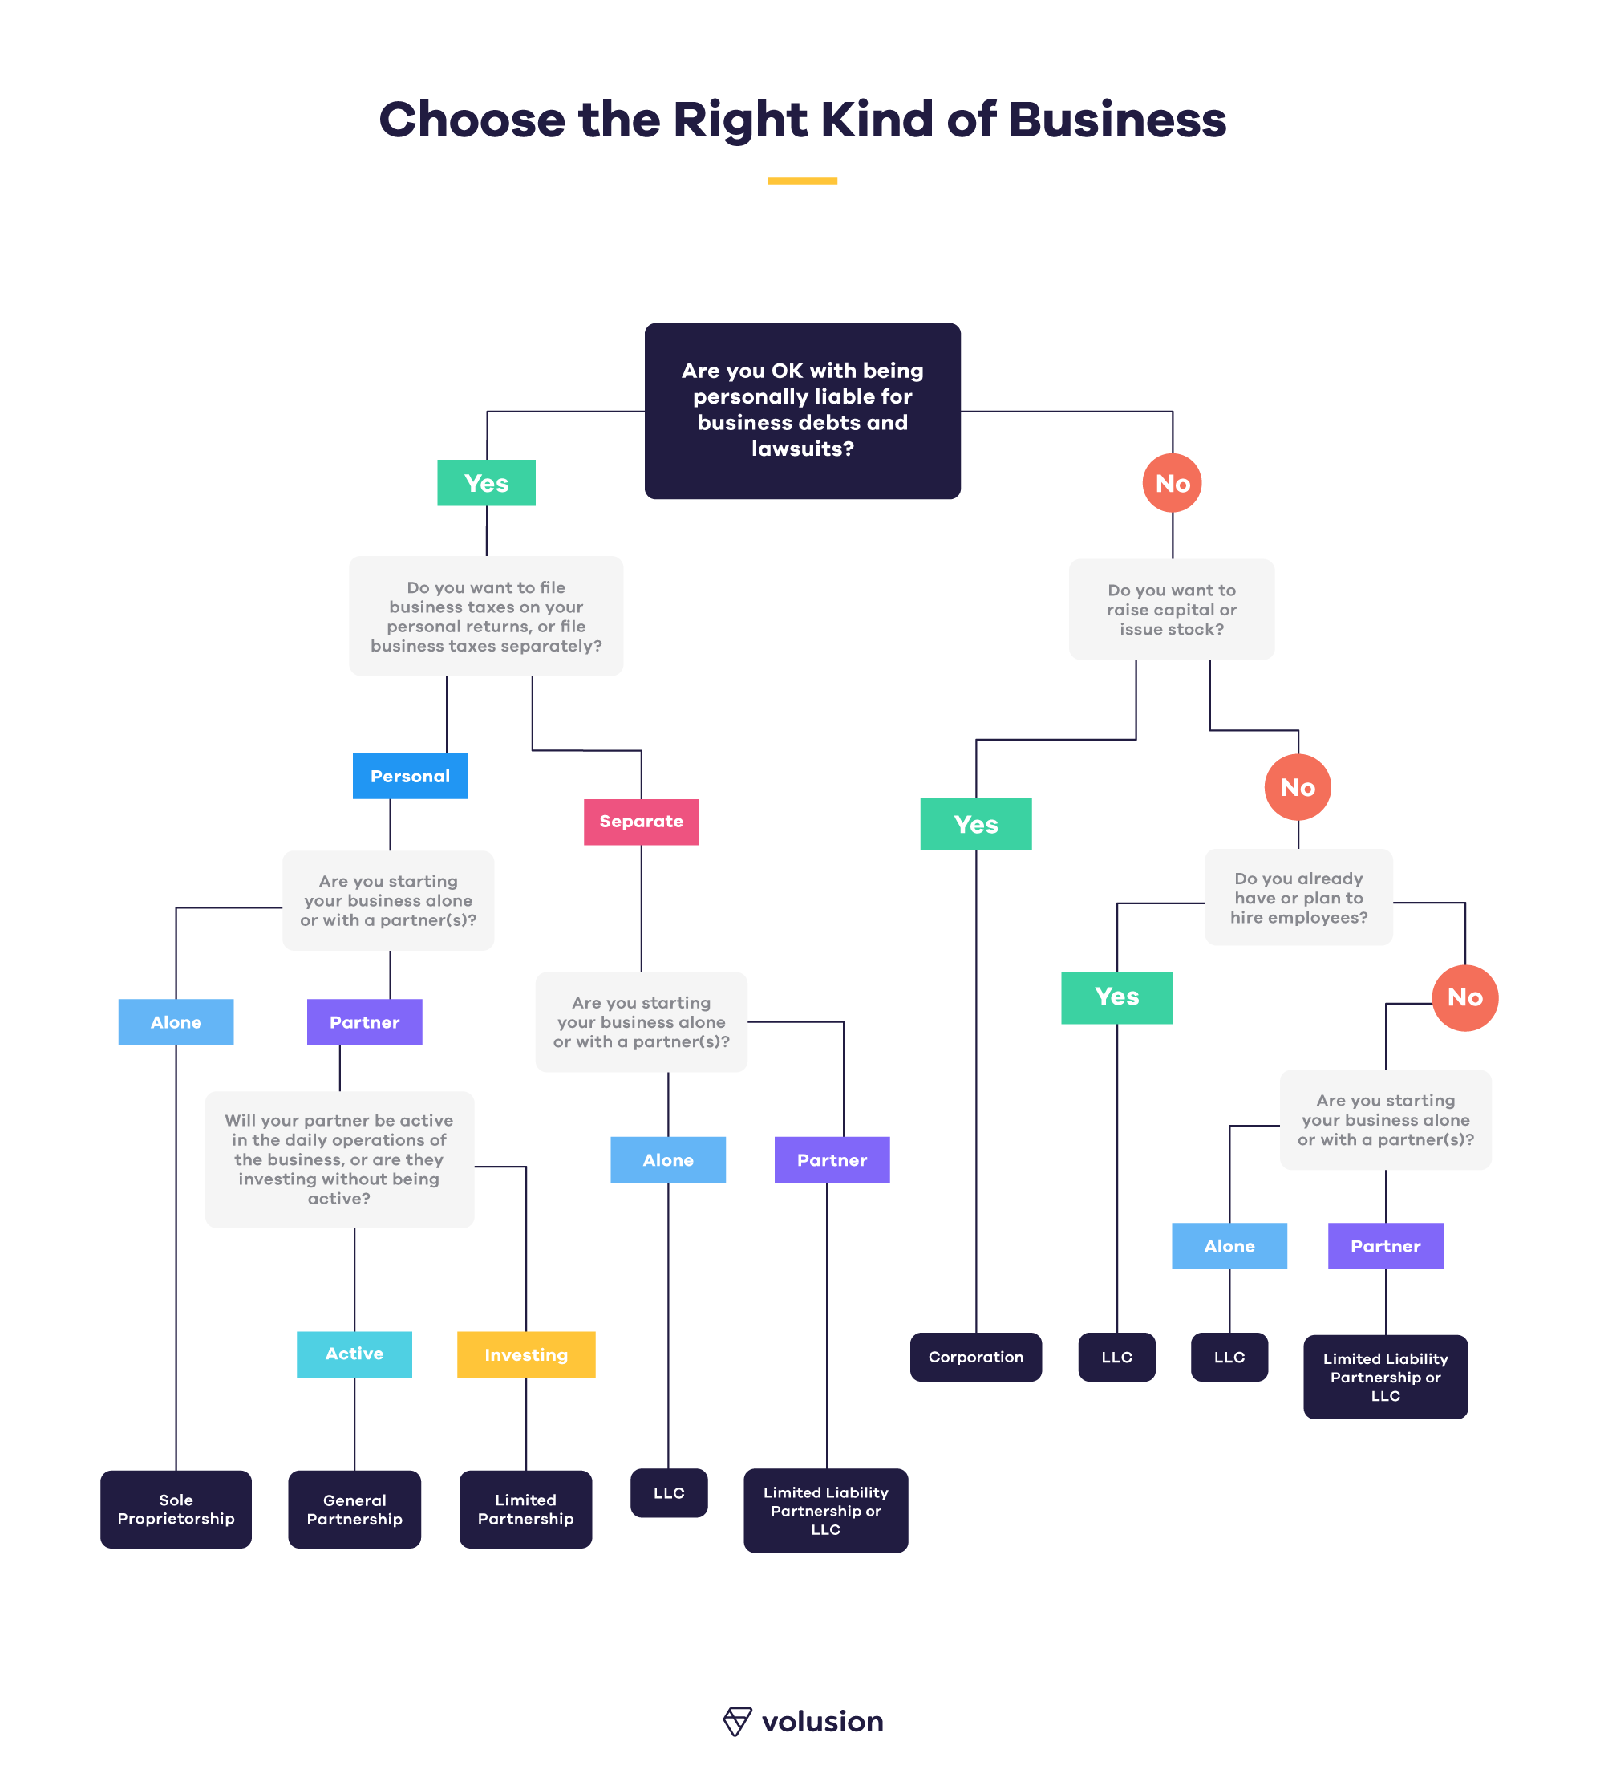

Slide 3
Business

Slide 4
1. A business is an organization or entity engaged in commercial, industrial, or professional activities with the primary objective of making a profit.
2. The term business refers to an organization or enterprising entity engaged in commercial, industrial, or professional activities.
3. It refers to organizations that exchange goods or services for money with the goal of making a profit on the transaction.

Slide 5
The purpose of a business
1. You make profit
(If this profit is returned to owners the business is known as a for-profit business)
2. invest all profit in achieving stated goals or improving infrastructure.

Slide 6
Business Formation

Slide 7
Business formation refers to the process of legally establishing a new business entity, such as a corporation, partnership, or sole proprietorship, by the laws and regulations.
Business formation is the decisions that need to be made when creating the structure of your business. Business structures, such as a sole proprietorship, a partnership, an LLC, a corporation, and a non-profit, will impact the future business decisions you’ll make for your business.

Slide 8
Types of business formations

Slide 9
Sole Proprietorship
Partnership
Limited Liability Company (LLC)
Corporation
S Corporation
Nonprofit Organization
Cooperative

Slide 10
Advantages & Disadvantages

Slide 11
Sole Proprietorship Advantages
Total control of the business: As the sole owner of your business, you have full control of business decisions and spending habits.
No public disclosure required: Sole proprietorships are not required to file annual reports or other financial statements with the state or federal government.
Easy tax reporting: Owners don't need to file any special tax forms with the IRS other than the Schedule C (Profit or Loss from Business) form.
Low start-up costs: While you may need to register your business and obtain a business occupancy permit in some places, the costs of maintaining a sole proprietorship are much less than other business structures.

Slide 12
Sole Proprietorship Disadvantages
Unlimited liability: You are personally responsible for all business debts and company actions under this business structure.
Lack of structure: Since you are not required to keep financial statements, there is a risk of becoming too relaxed when managing your money.
Difficulty in raising funds: Investors typically favor corporations when lending money because they know that those businesses have strong financial records and other forms of security.

Slide 13
Advantages Partnership
Easy to establish: Compared to other business structures, partnerships require minimal paperwork and legal documents to establish.
Partners can combine expertise: With more than one like-minded individual, there are more opportunities to increase their collaborative skill set.
Distributed workload: People in partnerships commonly share responsibilities so that one person doesn't have to do all the work.

Slide 14
Disadvantages Partnership
Possibility for disagreements: By having more than one person involved in business decisions, partners may disagree on some aspects of the operation.
Difficulty in transferring ownership: Without a formal agreement that explicitly states processes, a business may come to a halt if partners disagree and choose to end their partnership.
Full liability: In a partnership, all members are personally liable for business-related debts and may be pursued in a lawsuit.

Slide 15
Advantages Limited Liability Company (LLC)
Limited liability: As the name states, owners and managers have limited personal liability for business debts, whereas individuals assume full responsibility in a sole proprietorship or partnership.
Pass-through taxation: Owners of LLCs may take advantage of "pass-through" taxation, which allows them to avoid LLC and corporation taxes, and owners pay personal taxes on business profits.
Flexible management: LLCs lack a formal business structure, meaning that their owners are free to make choices regarding the operation of their businesses.

Slide 16
Disadvantages Limited Liability Company (LLC)
Associated costs: The start-up costs associated with an LLC are more expensive than setting up a sole proprietorship or partnership, and there are annual fees involved as well.
Separate records: Owners of LLCs must take care to keep their personal and business expenses separate, including any company records, whereas sole proprietorships are less formal.
Taxes: In regards to unemployment compensation, owners may have to pay it themselves.

Slide 17
Advantages Corporation
Owners aren't responsible for business debts: In general, the shareholders of a corporation are not liable for its debts. Instead, shareholders risk their equity.
Tax exemptions: Corporations can deduct expenses related to company benefits, including health insurance premiums, wages, taxes, travel, equipment and more.
Quick capital through stocks: To raise additional funds for the business, shareholders may sell shares in the corporation.

Slide 18
Disadvantages Corporation
Double taxation for C-corporations: The corporation must pay income tax at the corporate rate before profits transfer to the shareholders, who must then pay taxes on an individual level.
Annual record-keeping requirements: With the exception of an S-corporation, the corporate business structure involves a substantial amount of paperwork.
Owners are less involved than managers: When there are several investors with no clear majority interest, the management team may direct business operations rather than the owners.

Slide 19
Advantages of S Corporation
Pass-Through Taxation:
Income, losses, deductions, and credits “pass-through" the business and are reported on the shareholders' individual tax returns. This avoids the double taxation that is characteristic of regular C Corporations.
Limited Liability:
Shareholders have limited personal liability for the business's debts and obligations. Their personal assets are generally protected from business creditors.
Ease of Transferability:
Shares of stock in an S Corporation can be easily transferred without triggering adverse tax consequences.

Slide 20
Disadvantages of S Corporation
Restrictions on Ownership:
S Corporations are limited to 100 shareholders, and they must be U.S. citizens or residents. Certain trusts and exempt organizations may also qualify as shareholders.
Limited Classes of Stock:
An S Corporation can only have one class of stock, which can restrict the flexibility in structuring the ownership and distribution of profits.
Formation and Operational Formalities:
Similar to C Corporations, S Corporations must adhere to formalities such as holding regular shareholder meetings, keeping minutes, and adopting bylaws, which may be more administrative work compared to other structures.

Slide 21
Advantages Nonprofit Organization
Tax Exemption:
Nonprofits are often exempt from federal and state income taxes, as well as certain local taxes. Additionally, donors to nonprofits may be eligible for tax deductions.
Mission-Driven:
Nonprofits can focus on their mission rather than profit. This can attract individuals who are passionate about a cause and may be willing to volunteer or donate.
Access to Grants and Funding:
Nonprofits are eligible to apply for grants from government agencies, foundations, and other funding sources. These funds can support their programs and operations.

Slide 22
Disadvantages of Nonprofit Organizations
Limited Revenue Generation:
Nonprofits face restrictions on revenue-generating activities. While they can earn income through services or donations, there are limitations on the extent of profit-generating activities.
Fundraising Challenges:
Nonprofits often rely on fundraising for a significant portion of their income. This can be challenging, and the success of fundraising efforts can vary.
Regulatory Compliance:
Nonprofits must comply with complex and specific regulations to maintain their tax-exempt status. This includes restrictions on lobbying and political activities.

Slide 23
Advantages of Cooperative
Greater funding options: Cooperatives have access to government-sponsored grant programs, like the USDA Rural Development program, depending on the type of cooperative.
Democratic structure: Members of a cooperative follow the "one member, one vote" philosophy, meaning that everyone has a say, regardless of their investment in the co-op.
Less disruption: Cooperatives allow members to join and leave the business without disrupting its structure or dissolving it.

Slide 24
Disadvantages of Cooperative
Raising capital: Larger investors may choose to invest in other business structures that allow them to earn a larger share, as the cooperative structure treats all investors the same, both large and small.
Lack of accountability: Cooperatives are more relaxed in terms of structure, so members who don't fully participate or contribute to the business leave others at a disadvantage and risk turning other members away.

Slide 25
How do you choose a form of business?
1. Find your passion
Successful business owners build a business around what they love doing the most.
2. Discuss the details
Discuss your final business plan with other members of your business, if applicable, to ensure that everyone clearly understands future business operations.
3. Review the common business structures
The most important details related to your business, you can decide which business structure works best for your plan.

Slide 26
Mergers and Acquisitions
A merger occurs when two companies combine to form a new company.
An acquisition is the purchase of one company by another

Slide 27
Motives behind Mergers and Acquisitions
Gain Complementary Products
Acquiring complementary products was the motivation behind Adidas’s acquisition of Reebok.
Attain New Markets or Distribution Channels
The expectation is that combining the two carriers would create a company that could reach more markets than either carrier could do on

Slide 28
Realize Synergies
Combination of two or more entities to create a result that is greater than the sum of their individual parts.
Synergies can manifest in various forms, including cost savings, revenue enhancement, improved operational efficiency, and increased market share.

Slide 29
Hostile Takeover
A hostile takeover occurs when one company attempts to acquire another against the wishes of the target company's management and board of directors.
Unlike a friendly takeover, where the acquiring and target companies negotiate and reach a mutually agreeable deal, a hostile takeover is characterized by resistance from the target company.

